Slide 1
Management – Training and Professional Development for New and Seasoned Employees
Sherry Zou, Housing Programs Manager
City of Quincy, Massachusetts
June 14, 2024

Slide 2
The Trainings

Slide 3
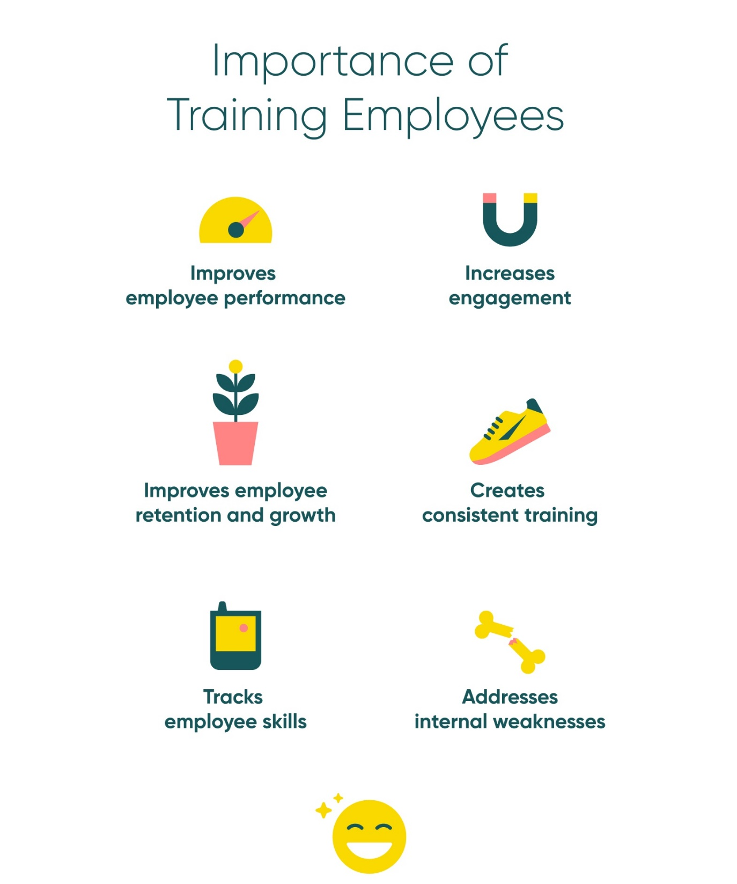

Slide 4
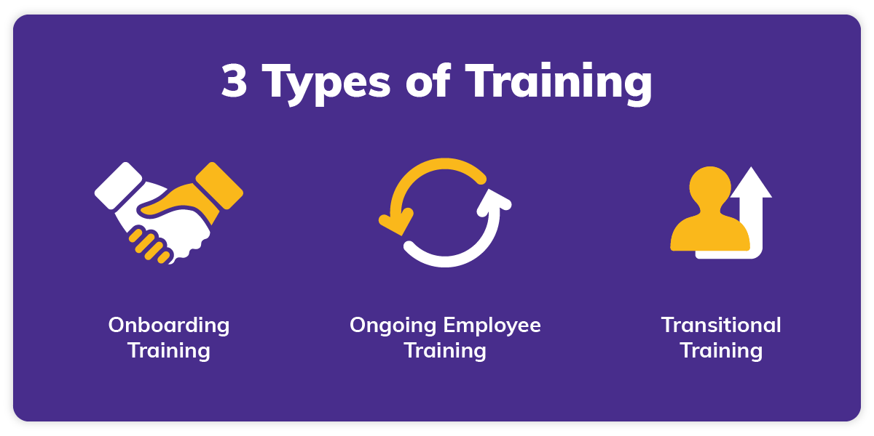
Training Types
Onboarding Training
Ongoing Employee Training
Mentoring
Coaching
Management training
Video training
Classroom training
Transitional Training
Job shadowing
Cross-training

Slide 5
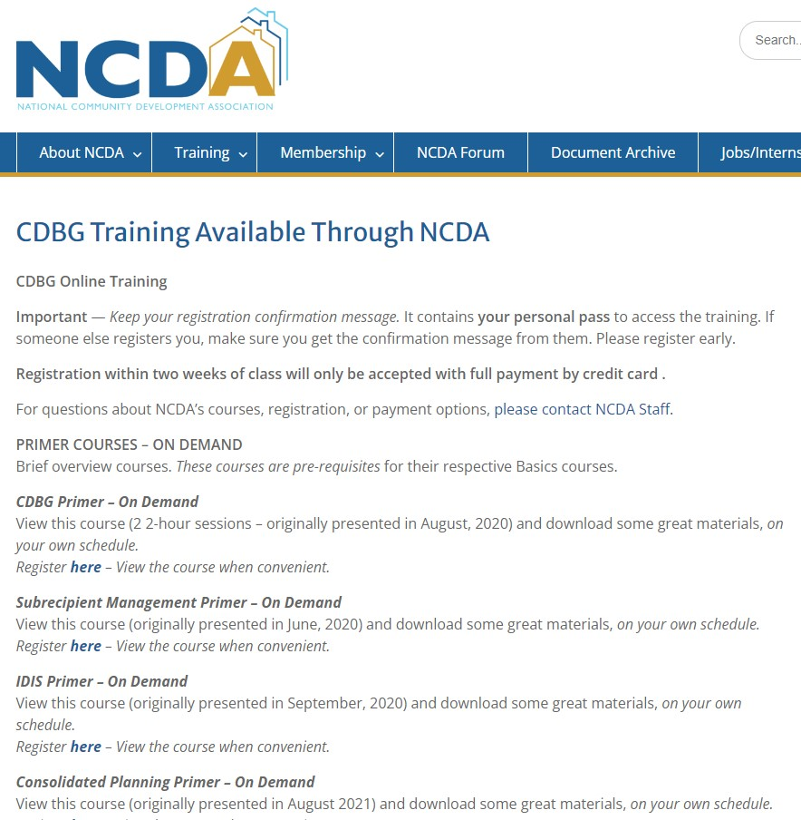
The Trainings

Slide 6
The Purpose

Slide 8
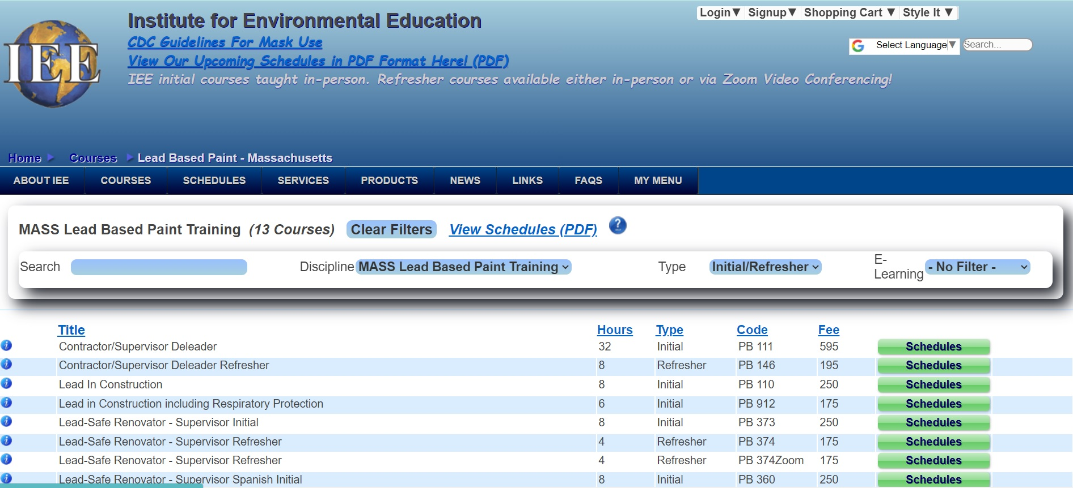
https://ieetraining.com/

Slide 9
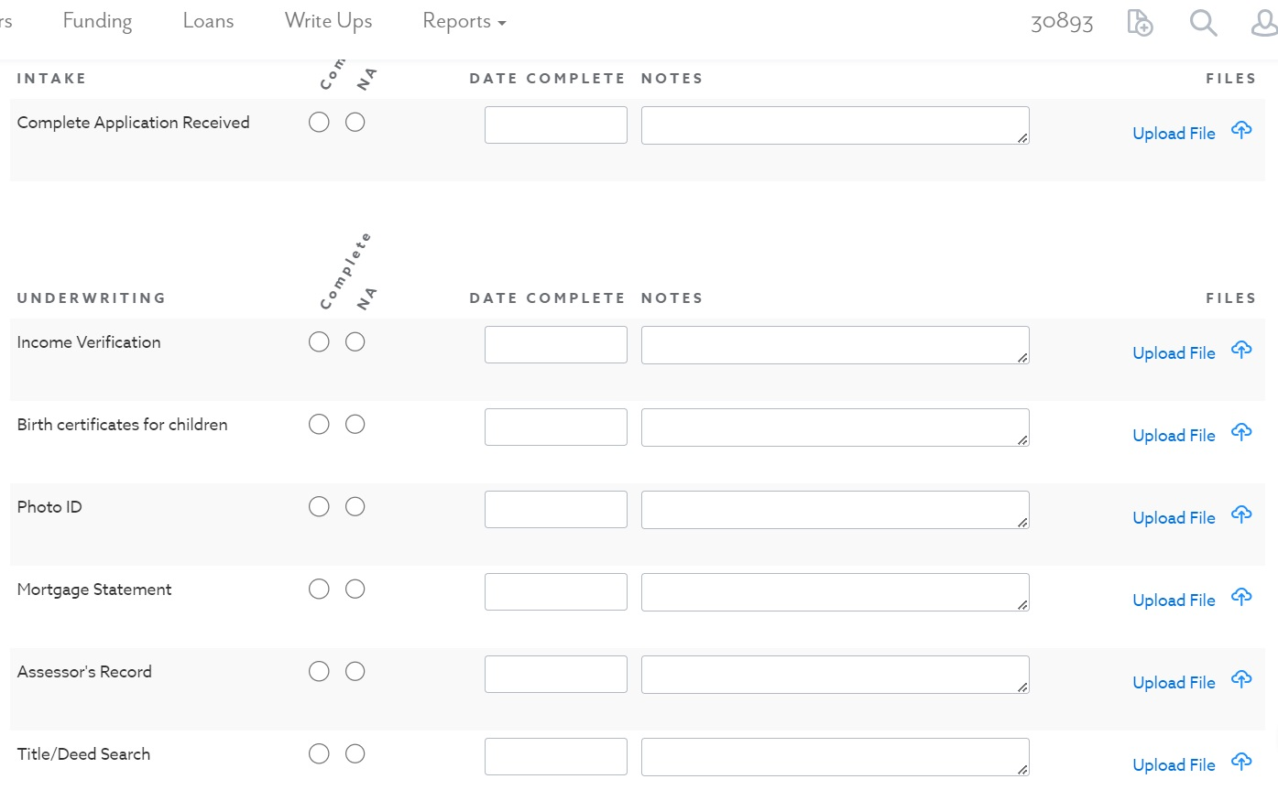
Example: Housing Rehab

Slide 10
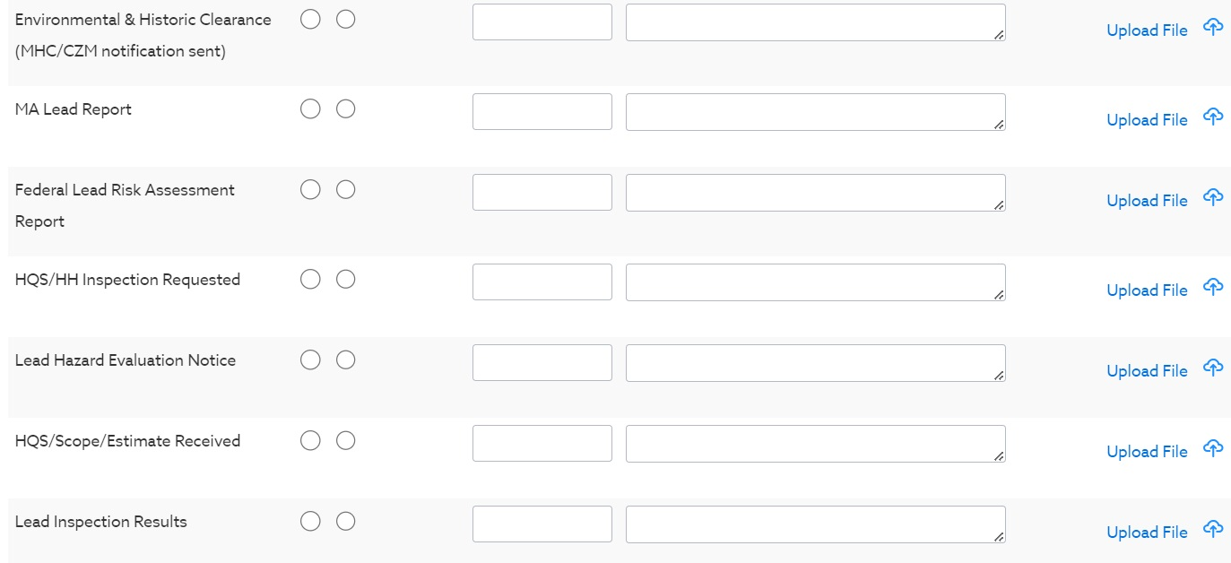
Example: Housing Rehab

Slide 11
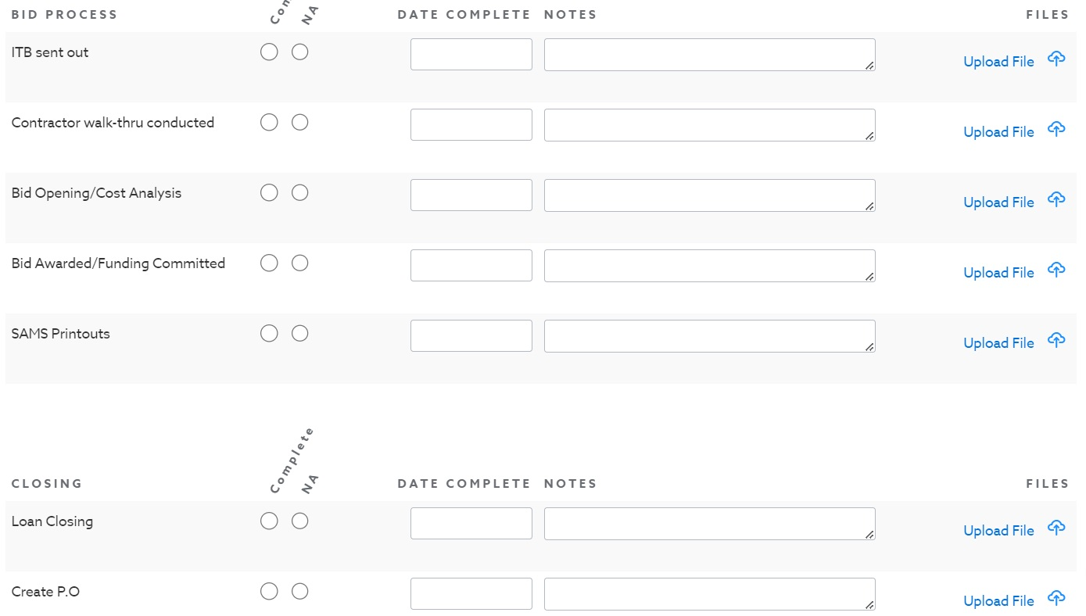
Example: Housing Rehab

Slide 12
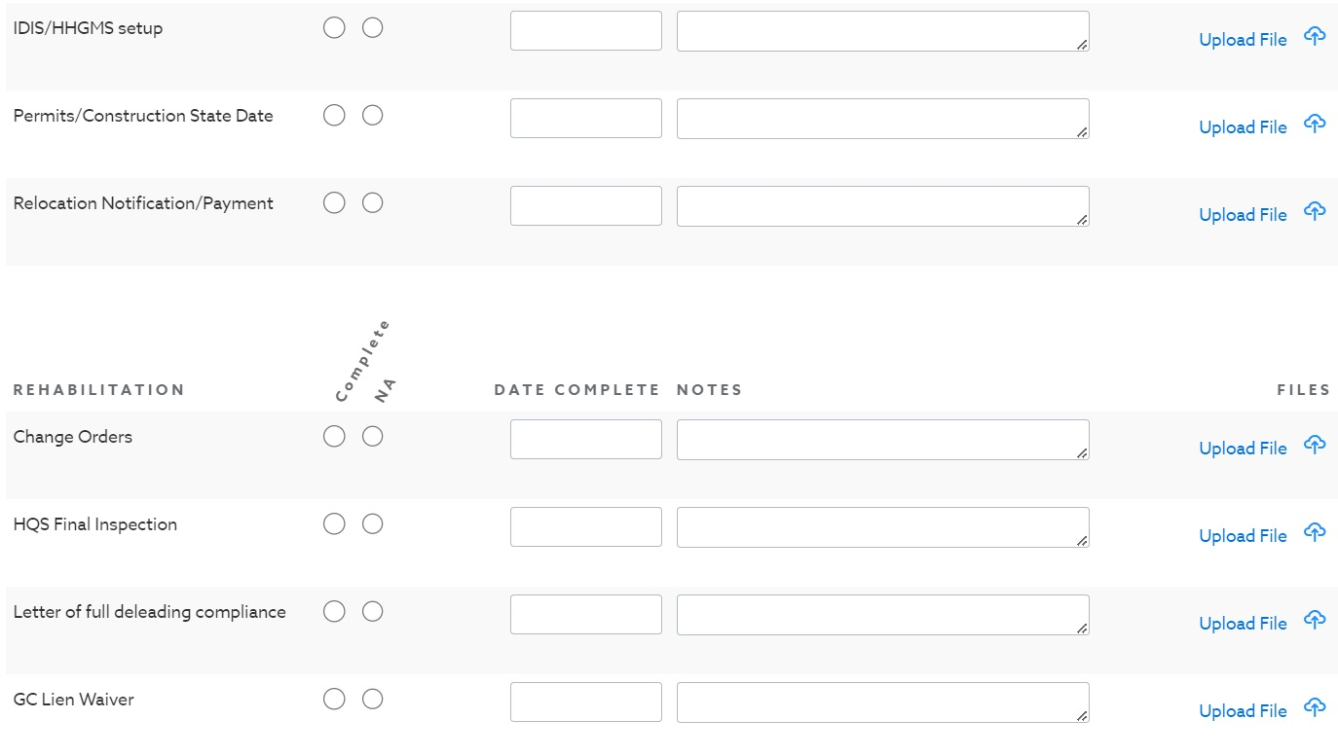
Example: Housing Rehab

Slide 13
Training DON’Ts
Favoritism
Information Overload
One-way conversations

Slide 14
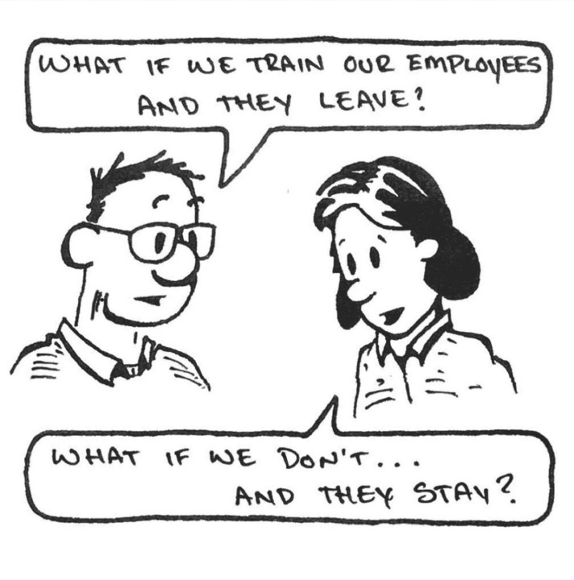
Thank You! Contact: Sherry Zou szou@quincyma.gov

